Slide 1
Introduction to RDBMS
Presenter
Ambili P K

Slide 2

Agenda
DBMS
RDBMS
Entity
Entity Set
Attributes
Relationship
Identifiers
Notes:
Frequently, presenters must deliver material of a technical nature to an audience unfamiliar with the topic or vocabulary. The material may be complex or heavy with detail. To present technical material effectively, use the following guidelines from Dale Carnegie Training®.
Consider the amount of time available and prepare to organize your material. Narrow your topic. Divide your presentation into clear segments. Follow a logical progression. Maintain your focus throughout. Close the presentation with a summary, repetition of the key steps, or a logical conclusion.
Keep your audience in mind at all times. For example, be sure data is clear and information is relevant. Keep the level of detail and vocabulary appropriate for the audience. Use visuals to support key points or steps. Keep alert to the needs of your listeners, and you will have a more receptive audience.

Slide 3
DBMS
Stands for Database Management System
Storage Purpose
Stored as rows and columns in Tables
Easy of use
Faster search
Can be used for generating reports
Stored as files
Reduce ambiguity
Security can be ensured

Slide 4
RDBMS
Stands for Relational Database Management System
Different tables which have connection can be linked and related
Easy of use
High Security
Data manipulation is possible
Central control of Data

Slide 5
Entity
Entity is a thing which can be easily identified
Entity is an object that exist and distinguishable from other objects
Ex: person, company, event..etc

Slide 6
Entity Set
Set of entities of the same type that share the same attributes
Eg: set of all persons, companies
Entity Set : STUDENT
Student A
Student B
Student C
Student D

Slide 7
Attributes
An entity is represented by a set of attributes, that is descriptive properties possessed by all members of an entity set.
Example:
customer =(customer_id, customer_name,customer_street,customer_city)
Domain
The set of permitted values for each attribute

Slide 8
Types of Attributes
Single and Composite Attributes
Singlevalued and multivalued Attributes
Derived Attributes
Descriptive attributes

Slide 9
Single and Composite Attributes
Single
cannot be divided further
Eg: RollNumber
Composite
can be divided further.
Eg: Name can be divided further into 3 parts consisting of FirstName. MiddleName, and LastName

Slide 10
Single valued and Multivalued Attributes
SingleValued
The attributes which have single value are single valued attributes
Eg: RollNumber
Multivalued
The attributes which has a set of values are called multivalued attributes
Eg: Student can have more than one telephone number.

Slide 11
Derived Attributes
These attributes are derived from the existing attributes of entities.
The value of a derived attribute is not stored, but computed when required.
Eg: Calculating age from the given Date of Birth

Slide 12
Descriptive Attributes
The attribute of the relationship is called descriptive attribute.

Slide 13
Relationship
A relationship is an association among several entities.
Example:
John depositor A-102
Customer entity relationship set account entity

Slide 14
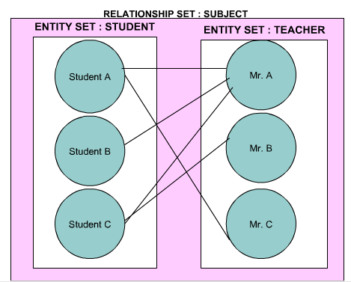
Relationship (Contd…)

Slide 15
Cardinality
It expresses the number of entities to which another entity can be associated via relationship set..
One to one
Many to One
One to Many
Many to Many

Slide 16
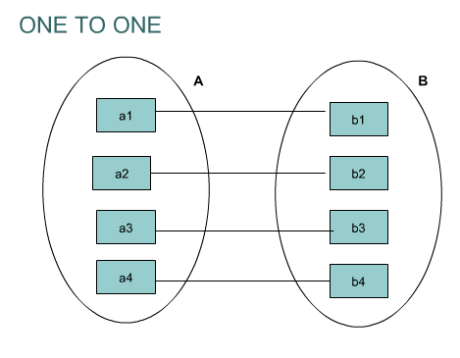
One to One Relationships

Slide 17
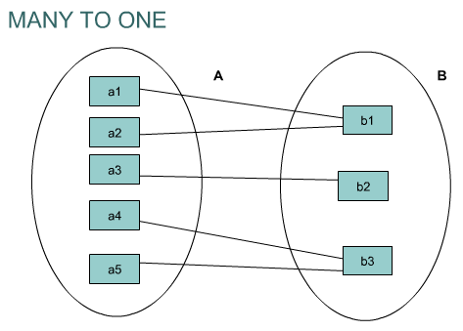
Many to One Relationships

Slide 18
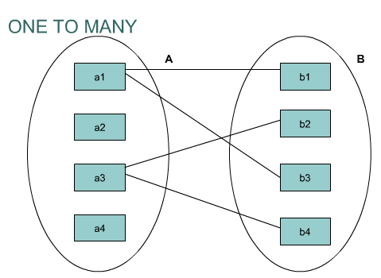
One to Many Relationships

Slide 19
Many to Many Relationships

Slide 20
Identifiers
Candidate Key
Primary key
Foreign key
Compound key
Alternate key

Slide 21
Candidate Key
All available unique, required identifiers of an entity is called Candidate key.

Slide 22
Primary key
A unique, required identifier of an entity is called Primary key.
The best one of candidates.

Slide 23
Foreign key
A Foreign key is a refernetial constraint between two tables.
A reference key to another entity
This key is the primary of another entity
Links the records in one database table to another table.

Slide 24
Compound key
A compound key is a key that consists of 2 or more attributes that uniquely identify an entity occurrence.

Slide 25
Alternate key
An alternate key (or secondary key) is any candidate key which is not selected to be the primary key.
Eg: employee_id, national_insurance_number
Primary key Alternate key

Slide 26
Some Important Terms
Relation : a table
Tuple : a row in a table
Attribute : a Column in a table
Degree : number of attributes
Cardinality : number of tuples
Primary Key : a unique identifier for the table
Domain : a pool of values from which specific attributes of specific relations draw their values
Notes:
Domain :
An attribute of an entity set has a particular value. The set of possible values that a given attribute can have is called its domain.
For example, the set of values that the attribute EMPLOYEE.id can assume is a positive integer of 5 digits.
Primary Key :
A unique identifier for the table (a column or a column combination with the property that at any given time no two rows of the table contain the same value in that column or column combination)

Slide 27
Recap

Slide 28
Agenda
DBMS
RDBMS
Entity
Entity Set
Attributes
Relationship
Identifiers
Notes:
Frequently, presenters must deliver material of a technical nature to an audience unfamiliar with the topic or vocabulary. The material may be complex or heavy with detail. To present technical material effectively, use the following guidelines from Dale Carnegie Training®.
Consider the amount of time available and prepare to organize your material. Narrow your topic. Divide your presentation into clear segments. Follow a logical progression. Maintain your focus throughout. Close the presentation with a summary, repetition of the key steps, or a logical conclusion.
Keep your audience in mind at all times. For example, be sure data is clear and information is relevant. Keep the level of detail and vocabulary appropriate for the audience. Use visuals to support key points or steps. Keep alert to the needs of your listeners, and you will have a more receptive audience.

Slide 29
Thank You....

